Slide 1
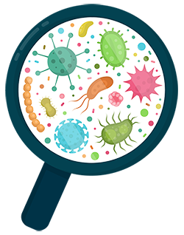
A Story about Coronavirus
and staying healthy

Slide 2

Coronavirus is a type of germ that
can make us unwell.

Slide 3
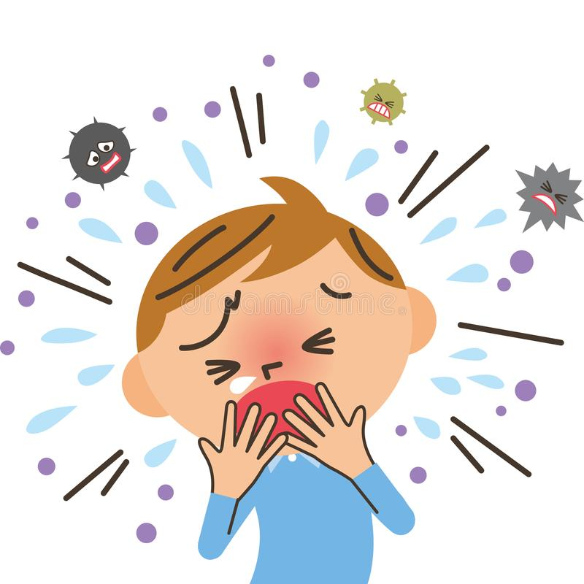
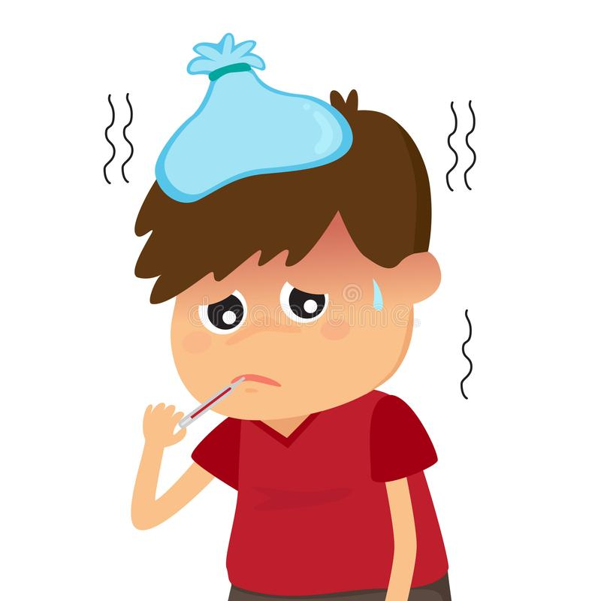
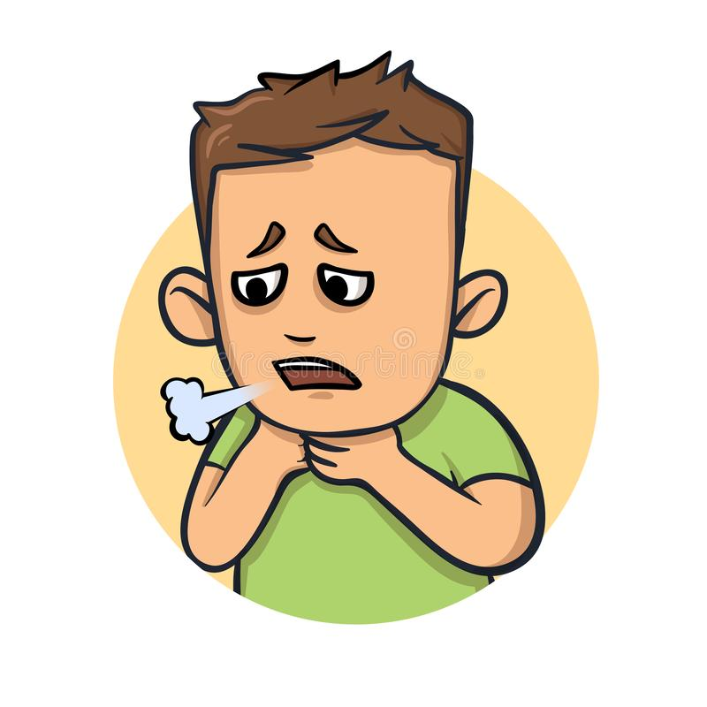
It can make us cough, feel very hot
or make it hard to breath

Slide 4
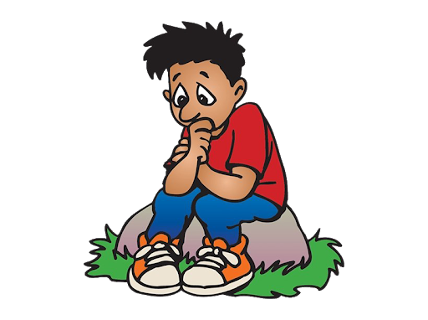
Sometimes I worry about Coronavirus
and becoming unwell

Slide 5

Its totally normal to feel a little worried
about this

Slide 6

If I let my worry get too big this could also
make me feel unwell

Slide 7
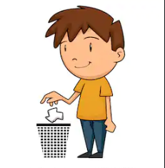
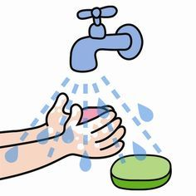
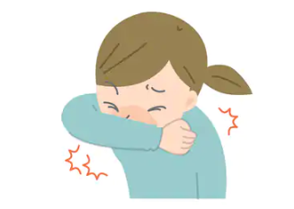
Things I can do to help stay healthy are…
Sneeze into my sleeve or a tissue, put the tissue straight into the bin and then wash my hands

Slide 8

When I do the these things I can relax.

Slide 9
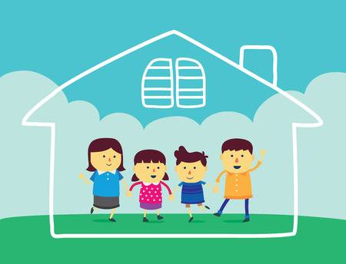
I might be asked to stay at home with
my family

Slide 10

This is to help me keep others healthy

Slide 11

When I stay at home I can be proud that I am helping.

