Slide 1
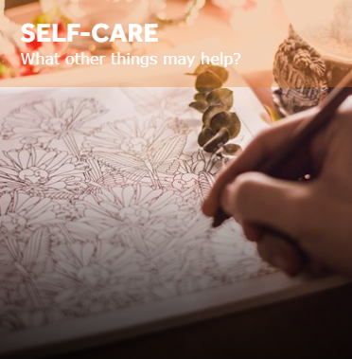
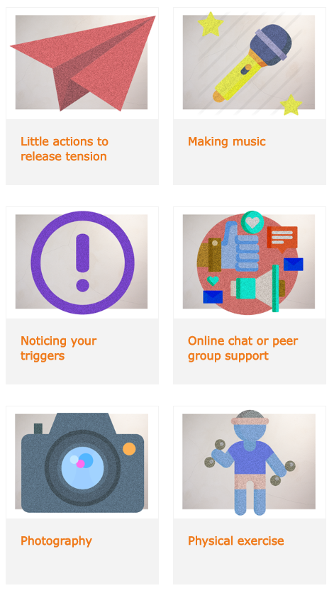
Self-Care
89 self-care strategies to help you manage your wellbeing compiled by other young people.
Visit www.onmymind.info for full list

Slide 2
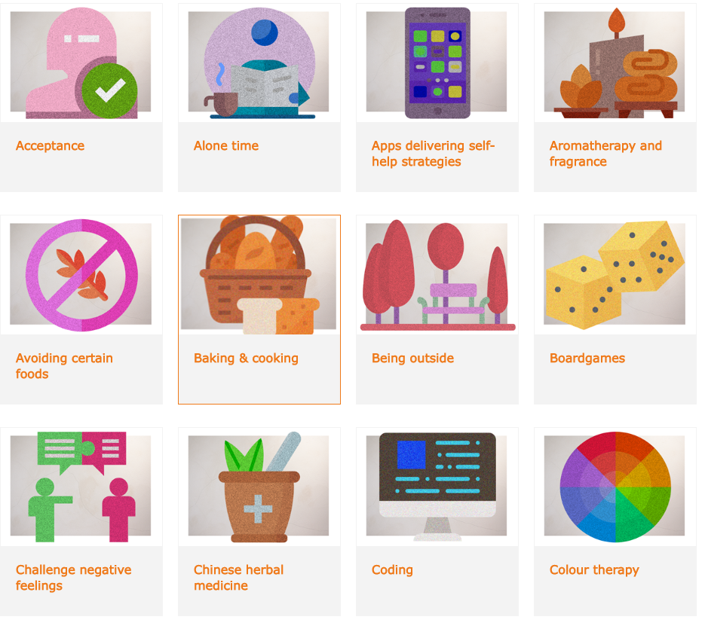
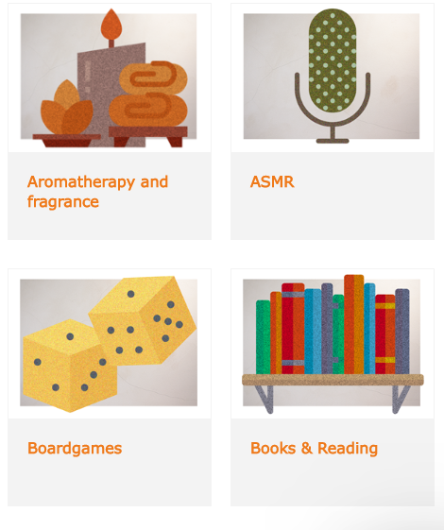

Visit www.onmymind.info for full list

Slide 3
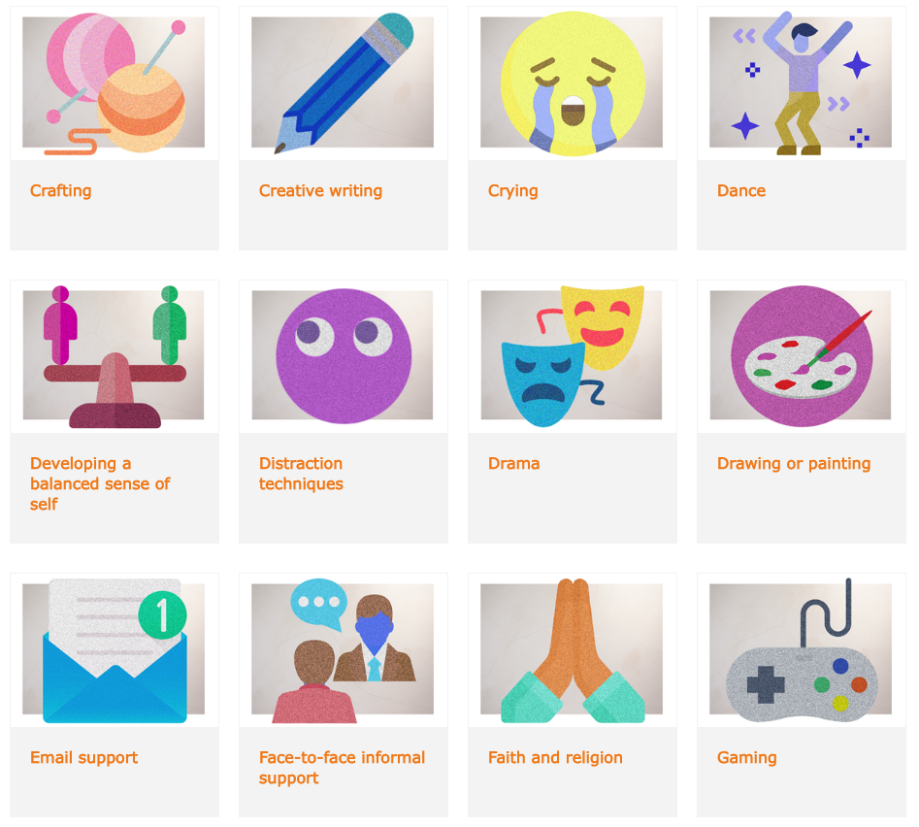


Visit www.onmymind.info for full list

Slide 4

Visit www.onmymind.info

Slide 5
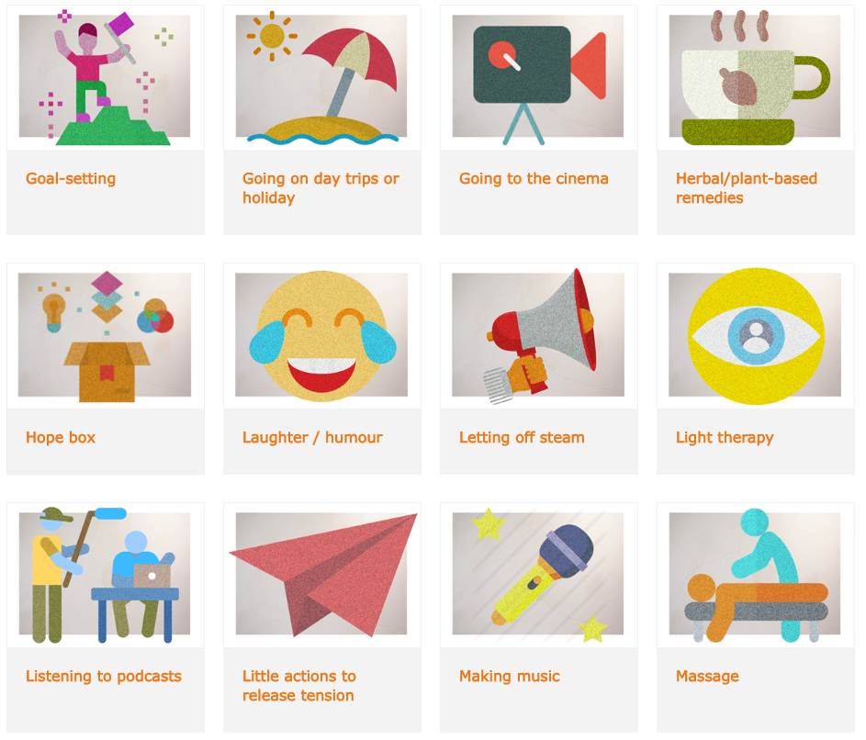

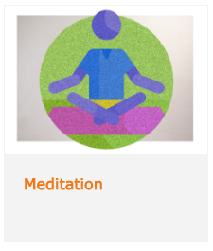
Visit www.onmymind.info for full list

Slide 6
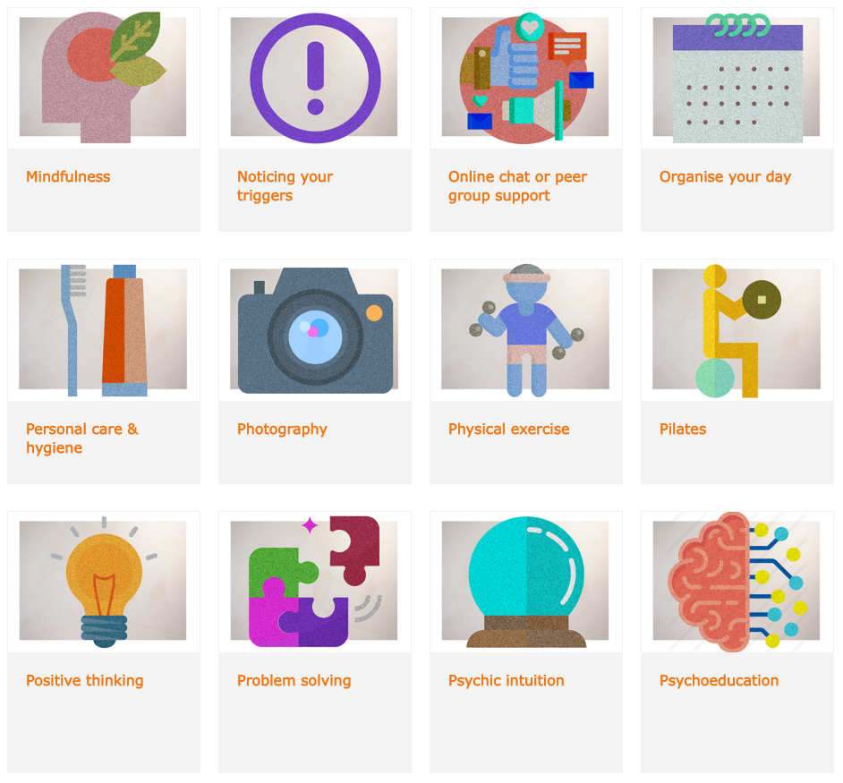
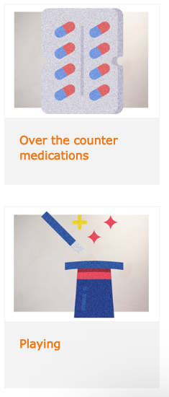
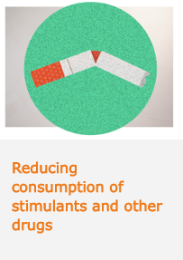
Visit www.onmymind.info for full list

Slide 7

Visit www.onmymind.info

