Slide 1

In the presentation:
The reception class team
Starting in September
Classroom routines and rules
Helping your child to be school ready

Slide 2
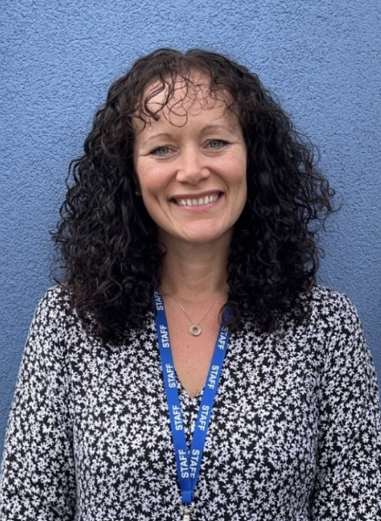
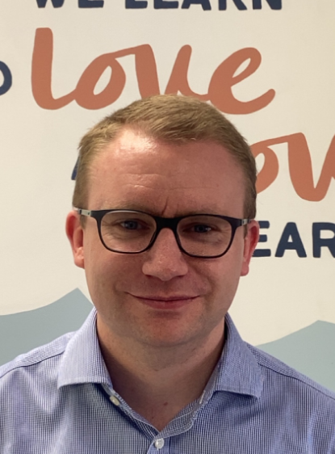
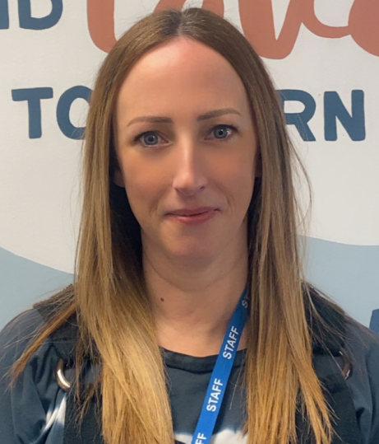
Meet the early years team
Louise Carey
Teacher (Mon - Tues)
Matt Gray
Teacher (Wed - Fri)
SENCO
Laura Taylor
Teaching Assistant
All teachers are responsible for every child within the Sparrows class. Your child will be supported to learn by all members of staff.

Slide 3
Transition to School
Before the summer:
Visits to nurseries
Home visits – Friday 3rd July and Monday 6th July
Teddy Bear’s Picnic – Wednesday 8th July 1.10pm
After the summer:
First & Second Day in School: Thursday 3rd September and Friday 4th September from 9.00am-12pm
Lunch stay: Monday 7th September 8.45am-1.30pm
Full time: Tuesday 8th September children will start full time education 8.45am-3.25pm (pick up from 3.15pm)

Slide 4
Start of the day
We open our gate at 8.45
Please drop off any older children to the main playground first
Children enter the classroom independently, put their things away and sit on the carpet ready to have a story or a 5 a day exercise and be registered
A staff member will be on the gate and can take any urgent messages
End of the day
The gate is open and children can be collected any time between 3.15 and 3.25
Please collect Sparrows children first before collecting older children
  KS1 home time 3.25
  KS2 home time 3.30
A member of staff will call children’s names as they see parents and carers arrive and children will come out to meet you at the gate
A staff member will be available to discuss any queries - no news is good news!
Kids’ club children are collected directly from the classroom

Slide 5
Our 3 School Rules
At PGPS we are
Ready
  -following routines and being in the right place, ready to learn.
Respectful
  -Respect our classroom – choose it, use it, put it away.
  -Respect others – remember our manners
  -Respect staff – we always listen to the teachers
Safe
  -We keep our hands and feet to ourselves

Slide 6
What the children need to bring to school…
A waterproof/warm coat or sunhat depending on the weather.
Their school book bag and water bottle every day (no other larger bags).
Their PE bag (stays in school) containing a t-shirt and shorts. Trainers (preferable to plimsolls) will be needed in the summer term.
A fruit snack is provided free every day. Milk is provided free until they are 5, after which it can be purchased through coolmilk.co.uk.
All of their property needs to be clearly labelled with their name.

Slide 7
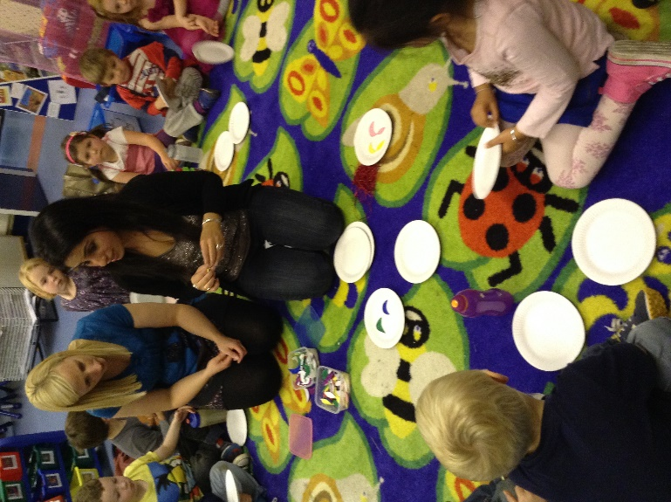
Parents as partners
Staff will always be available at the start or end of the day
Newsletters
Class Dojo
Class webpage
Star of the week celebration
Helping on trips
PTA & Governors

Slide 8
Preparing your child for school
Independence- encourage children to do simple things by themselves (toileting, dressing themselves, putting their own coat on, tidying up after themselves, etc)
Encouraging sharing and turn taking with family and friends
Talking to develop communication and negotiation skills
Establishing good sleep routines
Following simple instructions
This link has some fantastic information and tips on school readiness:
https://www.nhsggc.org.uk/media/258870/moving-on-to-school_update_1.pdf

Slide 9
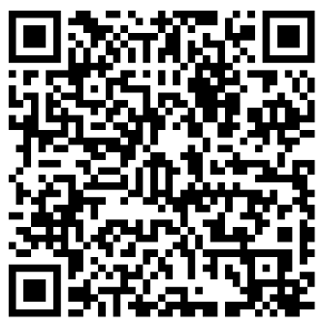
Any questions?
Please contact the school office and a member of the early years team will get back to you: office@pierrepont-gamston.notts.sch.uk
0115 981 9292
Go to pgps.org.uk, then class pages and new starters https://www.pgps.org.uk/page/?title=New+Starters+September+2026&pid=62

